Slide 1
Plasma Diagnostic Techniques Lecture 1
Deborah O’Connell
York Plasma Institute

Slide 2
Aims & learning outcomes
Aims:
Diagnostic techniques used to determine the properties of plasmas are examined. The physics behind particle and probe diagnostics, plasmas refractive index measurements, the spectroscopy of plasma emission from free and bound electrons, the scattering of electromagnetic radiation and fusion product detection are reviewed.
Learning outcomes - at the end of this module successful students will be able to understand:
The underlying physics behind diagnostic techniques used in plasma research.
Methods of measuring key plasma parameters from first principles.

Slide 3
Overview
18 Lectures, including a lab ‘tour’
2 Practical classes
Coursework
Two assignments, second half of the term
15% of module mark
Closed exam
1.5 hours
85% of module mark

Slide 4
Brief introduction to plasmas

Slide 5
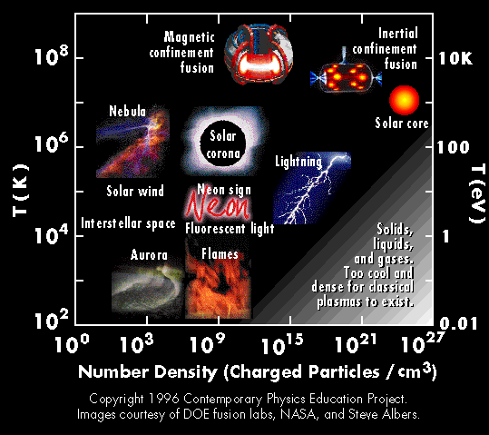
Temperature & density regimes

Slide 6
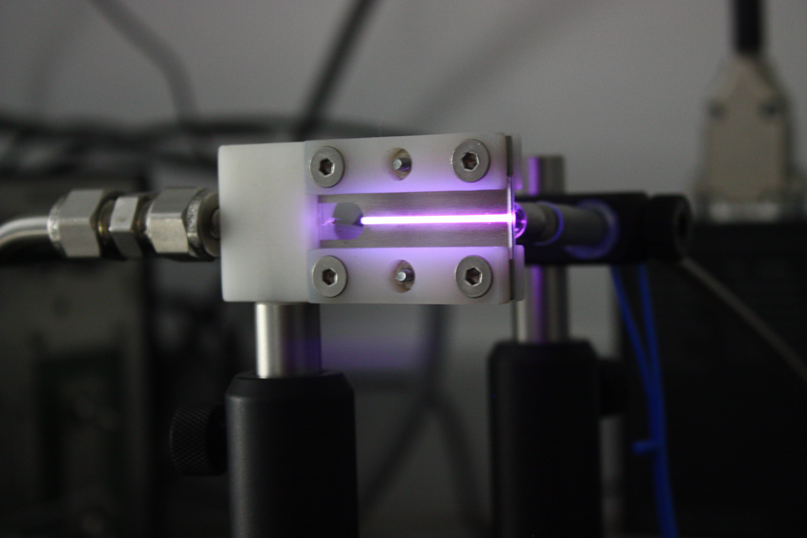
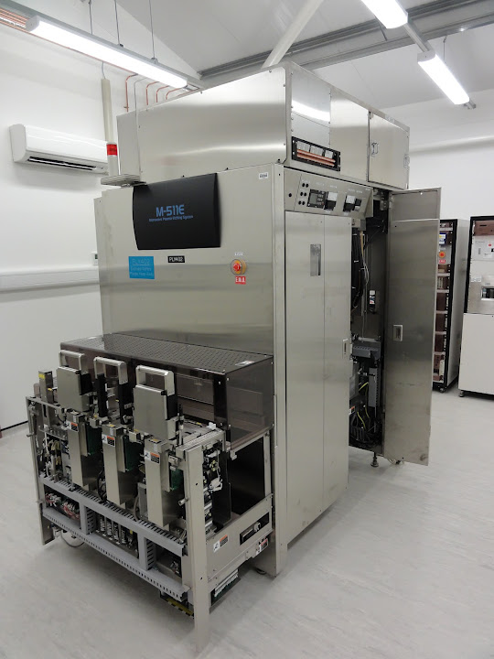
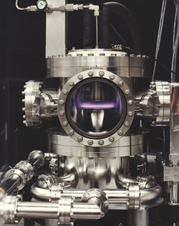
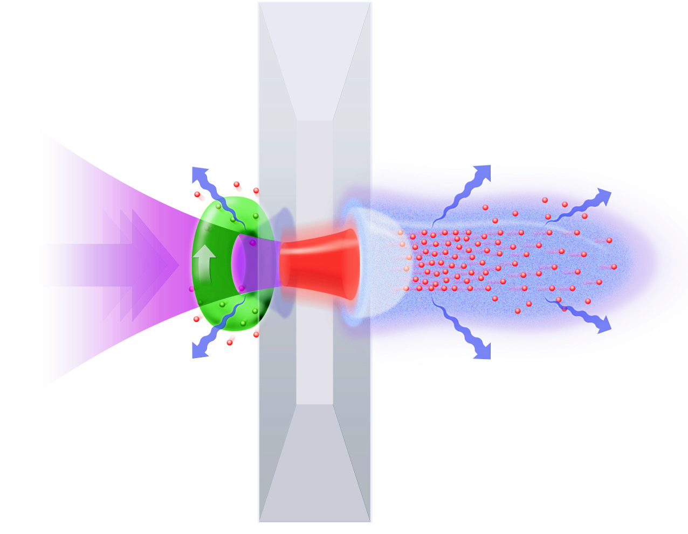
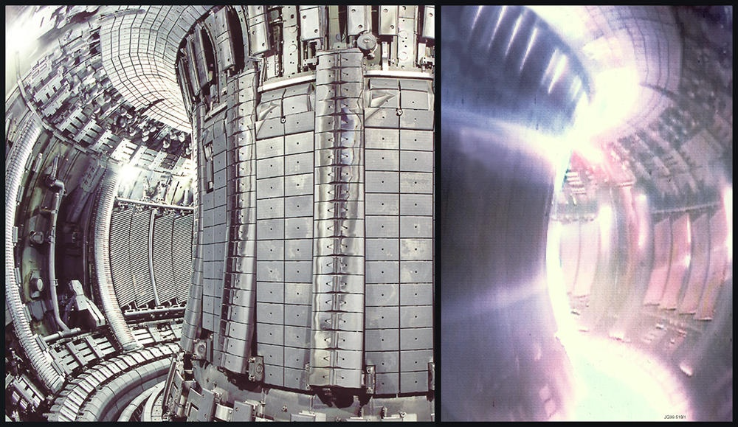
Plasma research at the YPI

Slide 7
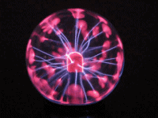
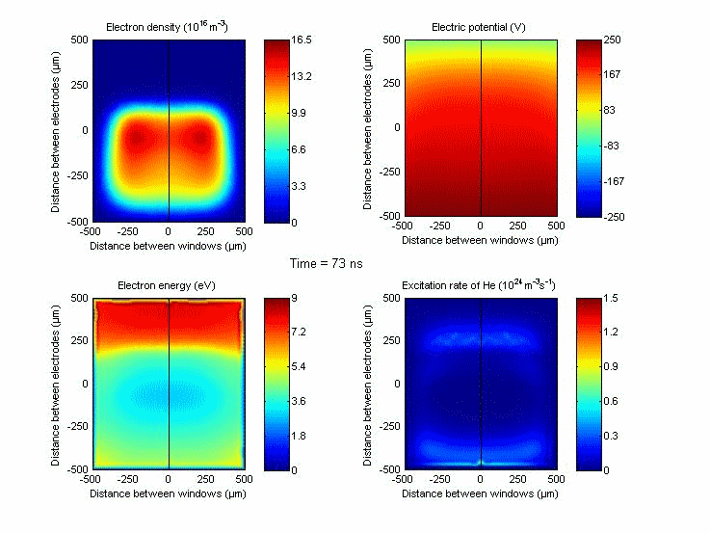
Plasmas & other disciplines
Optics
Atomic & molecular physics
Laser physics
Surface sscience
Material science
Electro dynamics
Statistics
Numerical simulations
Electrical engineering
Chemistry
Bio-medical sciences

Slide 8
Plasma: complex multi-particle system
What does a plasma consist of?
ionised gas with variety of particles
electrons
positive and negative ions
neutral particles (atoms, molecules, radicals)
excited species
dust particles
Parameters important to measure:
densities
distribution functions (temperatures)
electric and magnetic fields

Slide 9
What do we want to measure?
Typical quantities we want to measure:
Particle densities (typically measured in particles / m³)
Examples of particles include electrons, ions, and neutral reactive species
Temperatures (typically measured in eV, 1 eV = 11600 K or Kelvin)
Electron temperaures, Te, are ‘hot’ and measured in eV
Ions can be ‘cold‘ or ‘hot‘ (very dependent on plasma environment)
Neutrals tend to be ‘cold‘ and measured in K
Species kinetics & dynamics (typically measured in seconds)
Electron dynamics can be ‘fast‘ e.g. picoseconds
Neutral chemical kinetics and surface processes are much slower

Slide 10
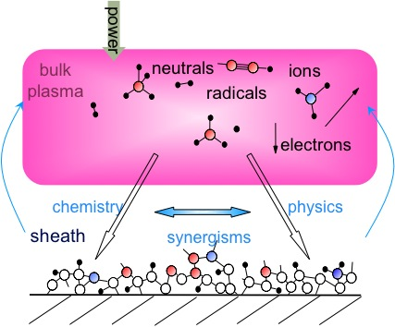
Plasma diagnostic challenges
Multiphase interfaces:
Plasma – gas – liquid – surface (solid)
Multispecies:
Electrons, pos. ions, neg. ions, neutrals, radicals, excited species, photons
Multiscale problem – time:
Electron dynamics: ps – ns
Ion dynamics: 100 ns – μs
Plasma chemistry: 100 μs – ms
Surface chemistry: s – min
Multiscale problem – space:
Surface structures: nm – μm
Charged particle gradients: μm – m
Neutral particle gradients: 10 μm – m

Slide 11
Overview of plasma diagnostic techniques
How do we measure plasma quantities and parameters?
Advantages and disadvantages
Complementary nature of multiple diagnostics & Combining diagnostics with simulations

Slide 12
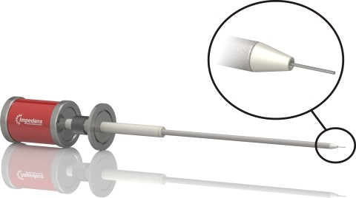
Electrical techniques
Electrical diagnostics
charged particles and fields
external current and voltage measurements
simple
non-intrusive
indirect
model based
global information only
probe measurements
simple
local information
direct
model based
agressive environment (high temperatures or reactive gases)
intrusive

Slide 13
Probe diagnostics
Example: Magnetron sputtering, time resolved measurements
Can be intrusive
Ref: Marcus Alden, Lund University

